Slide 1
Keep Calm and Make Music
EASTER EGGSTRAS!
Find it, Make it, Play it!

Slide 2
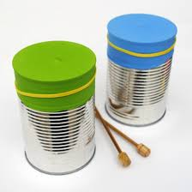
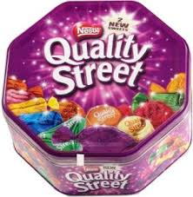
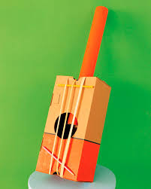
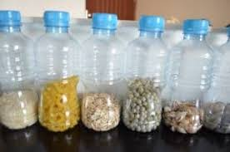
Find it, Make it, Play it!

Slide 3
Percussion instruments
Musical percussion instruments are instruments that make a sound when they are tapped, shaken or scraped.
Click here to watch some instruments being played
How are they being played?
Can you spot any instruments you know?
Notes:
This clip shows drums, a xylophone, cymbals, a tambourine, triangle, tubular bells

Slide 4
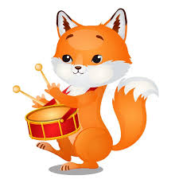
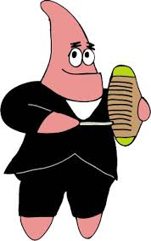
How to play
Percussion instruments can be played by:
Tapping Shaking Scraping

Slide 5
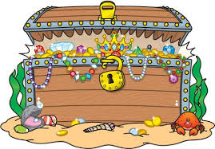
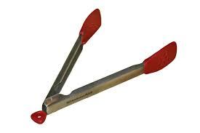
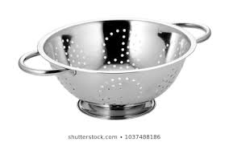
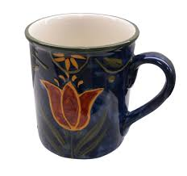
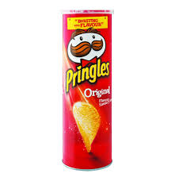
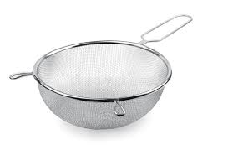
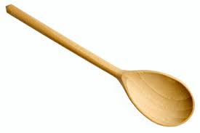
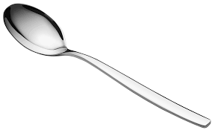
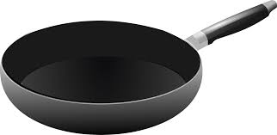
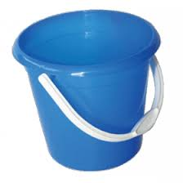
Go on a musical treasure hunt
Find something to tap, something to shake and something to scrape
Click here for some ideas What sound makers did you find?

Slide 6
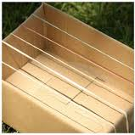
Get busy – make some instruments to play

Slide 7
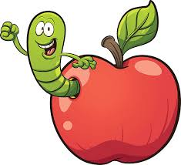
Using your new instruments
Click these links to follow the bee and then the worm
Follow the bee
Choose an instrument and play each time the bee lands on a flower
Follow the worm
Choose an instrument and play each time the worm (in his apple) lands on a symbol

Slide 8
Use your instruments to add sound effects to a story Read the story (if you have the book) or click the links to hear the story (pausing the video each time you get to the place where you need to add a sound)
Peace at Last by Jill Murphy
Add sounds for the clock, the dripping tap, the fridge, the alarm clock
We’re going on a bear hunt by Michael Rosen
Add sounds for walking, the grass, splashing, mud, stumble-trip, snow, tiptoeing, running home, shutting the door

Slide 9
Get creative…
Write your own “sound” story about a walk around your home
What will you come across? Someone washing up?
The clock on the wall? Someone singing in the shower? Someone knitting?
Don’t forget to include walking sounds
Draw a picture showing all the things you include

Slide 10
Put on a show!
Rehearse telling and playing your story until it is the best it can be then perform it to someone and / or record it and send it to your relatives and friends to cheer them up

