Slide 1
Keep Calm and Make Music
Balloons and Party-poppers

Slide 2
Sound seekers Party sound-makers
Mini sound explorations and discoveries

Slide 3
Party time…
If you were getting ready for a party, what would you need?
Can you make a list or draw some pictures to show what you would need? Don’t forget the decorations!
Can you spot the things that you came up with on this clip from Sesame Street

Slide 4
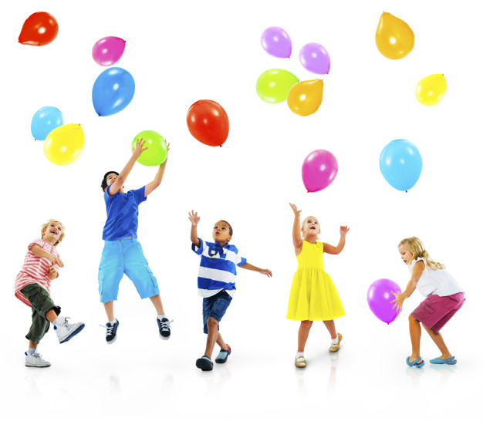
Ballooning around
What do you like to do with balloons?
bounce them?
pop them?
let them go?
Enjoy this clip and see what they do with their balloons – join in if you have a balloon (or even if you don’t!)
The Wiggles - Balloon Dance
How long can you keep it in the air?
Try passing it to someone while you’re dancing

Slide 5
Sounds like a balloon to me…
Did you know that you can make all sorts of sounds using balloons?
We know that balloons can go
But this clip shows you how a musician has used only balloons to create music 99 Red Balloons

Slide 6
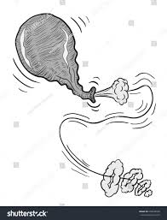
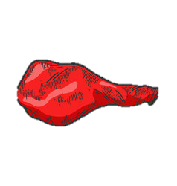
Bursting to give it a go
Spend some time exploring balloons
trying out the different sounds you can make
Try blowing it up and letting the air out?
Try stretching it
What about pulling and pinging it?
Can you make sounds by squishing or rubbing your balloon?
What about flapping it?
Can you blow it up and let the air our really slowly?
…What else could you try?

Slide 7
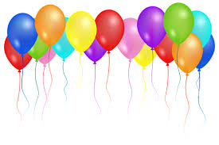
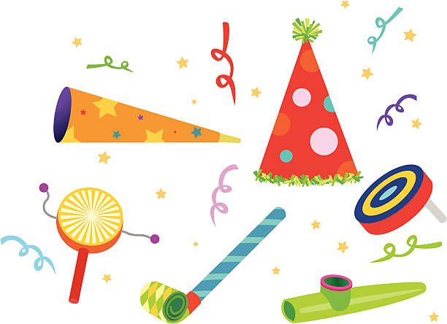
Balloon Tunes….
If you can, try and record the different sounds you have discovered and share them with someone else
What other party sound-makers can you find? Have fun playing them while you dance to this song
Dance Party

Slide 8
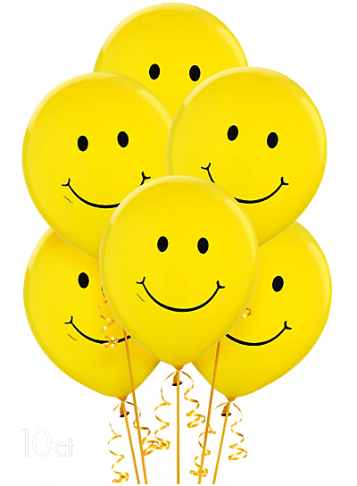
Happy Balloons
Balloons make lots of people feel happy
Watch this little story to see how a balloon can make someone smile….Red Balloon

Slide 10
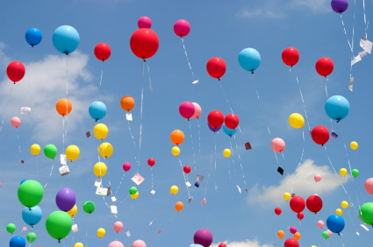
Have a very happy day!

