Slide 1
Keep Calm and Make Music
Sound Seekers – Rhythm of Life

Slide 2
Sound seekers
Mini sound explorations and discoveries

Slide 3
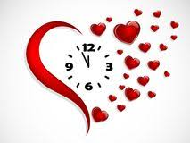
Rhythm of life
Find a place to be really quiet and find your heart beat
Listen to it, feel it beating
Tap your feet in time to your heart beat
Run up and down the stairs / on the spot / around your garden for 30 seconds – 1 minute
Find your heart beat again – feel it, tap it – what do you notice?
Try breathing in for 4 heart beats and out for 4 heart beats
Try breathing in and out for a longer count of heart beats – what do you notice?

Slide 4
Beating and Breathing
Our heart beat and our lungs breathing are our natural body rhythms
When we exercise they speed up, when we’re calm they slow down
Listen to this song, listen for the heart beats at the beginning (introduction) and at the end (coda)
Try adding a steady tapping beat while you listen
Try adding steady movements while you listen
e.g. arms up / down to the count of 4, arms left / right to the count of 4
Try singing along with the song

Slide 5
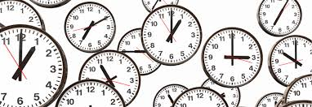
Make each second count
Find a ticking clock
Tap in time to the ticks
Walk around your room in time to the ticks
What else could you do in time to the ticking clock?
Is there anything else you can find that makes a regular / steady beat like your heart or a clock?

Slide 6
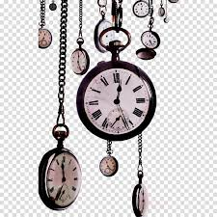
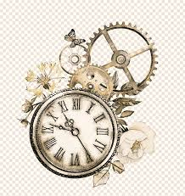
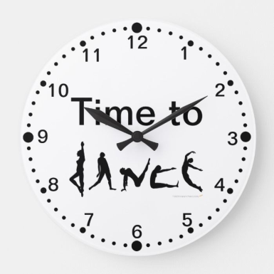
Tick tock…
Listen to this piece - clockwork by Philipp Klein
Listen for the clock, can you hear it ticking?
Can you hear when it gets wound back up?
What happens at the end?
Listen again and this time move your head, hands or feet in time to the tick-tock sound.
Sit on the floor and hold hands with your partner as if you were going to row the boat. Move back and forwards in time to the music
Standing up, make big arm sweeps and circles in time to the long notes
As it slows down at the end, match the music and slowly curl up into a ball on the floor
Now, can you put all those actions together to make a dance

Slide 7
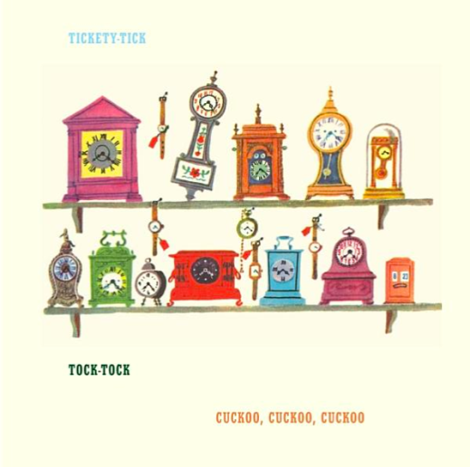
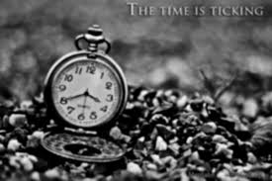
Tick tock….
Now listen to this music – clocks by Guru Prasanna
How many different tick-tocks can you hear?
Listen carefully to the beginning and see if you can join in with the slow one, the fast one, and the medium speed one.
Stamp when you hear the clanging sound
Draw a picture of the different clocks you can hear

Slide 8
Tick tock, tick tock…
Did you like the two pieces?
Which sounds were your favourite?
Do you know any songs about a clock?
Can you find another piece of music that has a ticking sound?
Notes:
Songs about clocks…
Hickory Dickory dock
My Grandfathers clock
Coldplay - Clocks

Slide 9
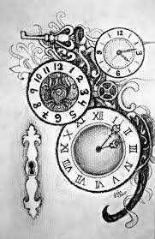
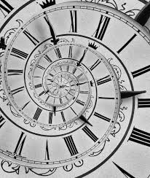
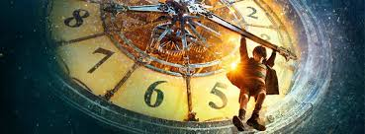
…and now….
Can you find something that makes a winding sound?
Can you make your own clock music using
A ticking clock
An alarm sound
A winding sound
Your own sounds
Try recording it on a phone or iPad and share it with someone special
There is a fabulous film called Hugo which features a clockmaker – see if you can find it and watch it
(Pssst – here is a sneak preview…Hugo)

