Slide 1
Keep Calm and Make Music
Rock, Paper, Scissors

Slide 2
Rock paper scissors shoot!

Slide 3
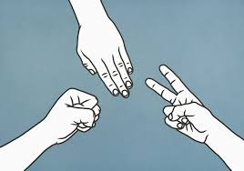
Play the game
Find someone to play with and have a game of Rock, Paper, Scissors.
Play the best of 3 and see who wins
Which one do you think is best to choose?
or or
Was it you?

Slide 4
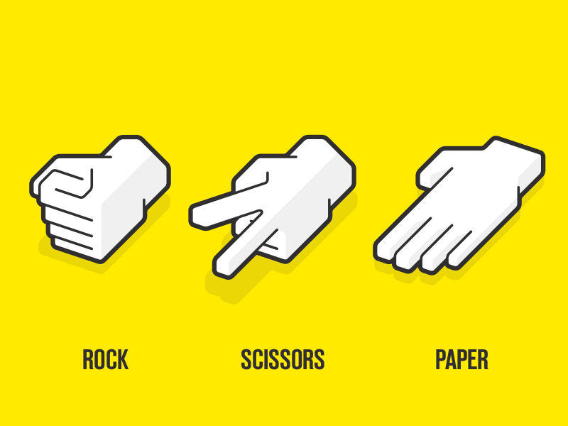
Chant it
Rock paper scissors shoot
Chant this 4 times with everyone who’s working together
Tap the pattern on your knees as you chant
Carry on chanting but drop out the word rock (repeat 4 times)
Next time drop the word paper and repeat x 4
This time, guess which word you’re going to drop out……
Did you get it right?
Of course you did!

Slide 5
Tap the rhythms
How many taps for rock?
1
How many taps for paper?
2
How many taps for scissors?
2
How many taps for shoot?
1
So…what do you notice about paper and scissors?
Is rock the same as anything?
They are the same
It’s the same as shoot

Slide 6
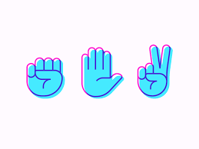
Make some patterns
Lets use the words to make some patterns
Try these out first, clap and chant:
rock rock paper paper
scissors paper rock rock
paper rock scissors scissors
Can you try playing the patterns more than once?
Can you try playing the patterns one after the other?

Slide 7
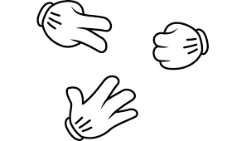
Take it a little further….
We could try putting the rhythms on a grid like this
Try clapping these through altogether
1 | 2 | 3 | 4
rock | rock | paper | paper
X | X | X X | X X
paper | rock | scissors | scissors
X X | X | X X | X X

Slide 8
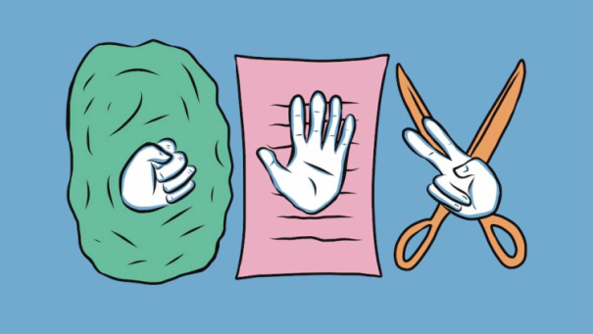
Now try your own
Can you make up your own patterns using
x x x xx
You could write or draw your patterns using words, pictures or Xs
Try putting 2 patterns together to make an even longer one
Share your patterns with someone else and see if they can clap / play them too

Slide 9
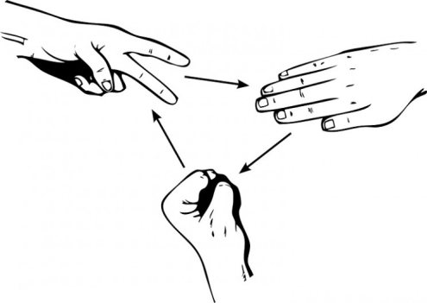
1, 2, 3…Shoot!
Choose your 4 favourite patterns that you have made and put them together to make a Rock, Paper, Scissors piece of music.
You could notate them in a grid so that you have something to follow (there is a grid on the next slide you could print off)
Perform them to someone else, or record them using an iPad, phone or tablet to share with someone special

Slide 10
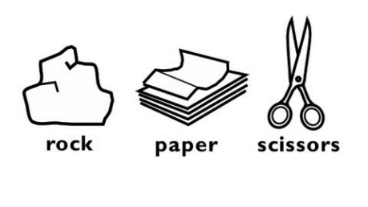
1, 2, 3…Shoot grid (to print)
My name:
Notes:
This slide is only for printing and will not interact on the screen
If you need a grid on your screen so that you can work with a group in school, please scroll on to end of the powerpoint

Slide 11
Listen to this…
This is a clip of a musician who has created a piece of music using rocks, paper and scissors to create the backing track.
Listen and see what you think
Andrew Huang - Rock, Paper, Scissors
Could you perform your own Rock, paper scissors pattern along to the music?

Slide 12
Fabulous You are a

Slide 13
1, 2, 3 Shoot altogether…
1 | 2 | 3 | 4
Notes:
To create your music together either input Xs, click and drag / copy and paste the pictures, or use the word rock / paper / scissors
You will need to make sure the power-point is in edit mode not slideshow, but once completed you can switch back to slideshow for a full screen showing your new music

