Slide 1
Keep Calm and Make Music
The Balancing Song

Slide 2
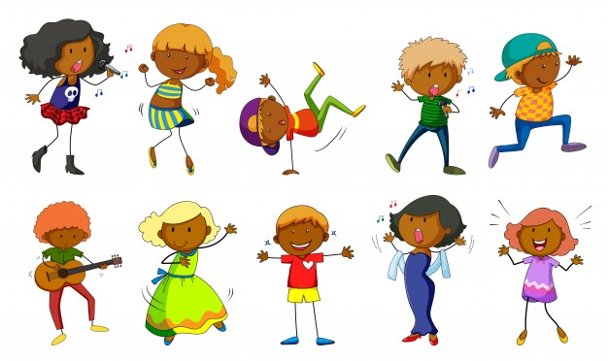
Getting creative with a song

Slide 3
When I am balancing….the song
Listen to the song
Move your head from side to side in time with the steady beat, then try tapping your knees in time to the steady beat.
How else could you keep the steady beat?
Listen again and find the bell chime sound – trace it in the air with your finger
Explore the different balances you can do
Can you balance on one foot?
Can you balance on your hands?
Can you balance on your knees?
Try as many different shapes and balances you can and
take pictures of your different balances
You can listen more
than once

Slide 4
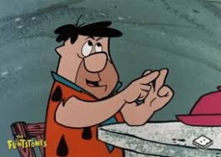
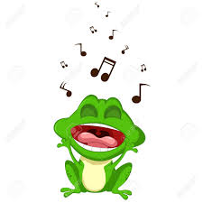
Listen again…..
Count how many times you hear…
Balancing
Goal
Everyone
See how much of the song you can join in with
What does it make you think about? Draw a balancing picture

Slide 5
When I am balancing….the movie!
Click play on the blue square to watch some amazing balancing

Slide 6
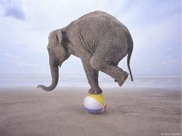
When you are balancing…
…no wobbling…
Find a nice big space and try some of your own balances again - don’t forget to hold your position
Play and sing the song, changing your balance position for each new line
Work out a balance sequence that will fit in the instrumental verse
Can you work with someone else to add simple sounds during the instrumental verse that emphasize when you change your balance position
Make a slide show of your balances and body shapes to show while playing and singing the song
You could use props like
ribbons or a scarf

Slide 7
…and show yourself off…
Share your performance with someone – maybe you could record it on an iPad and share it with someone else in your family or class.
If you’re at home, maybe you could perform whilst face-timing a friend or relative
Enjoy !!

