Slide 1
Keep Calm and Make Music
Underwater

Slide 2
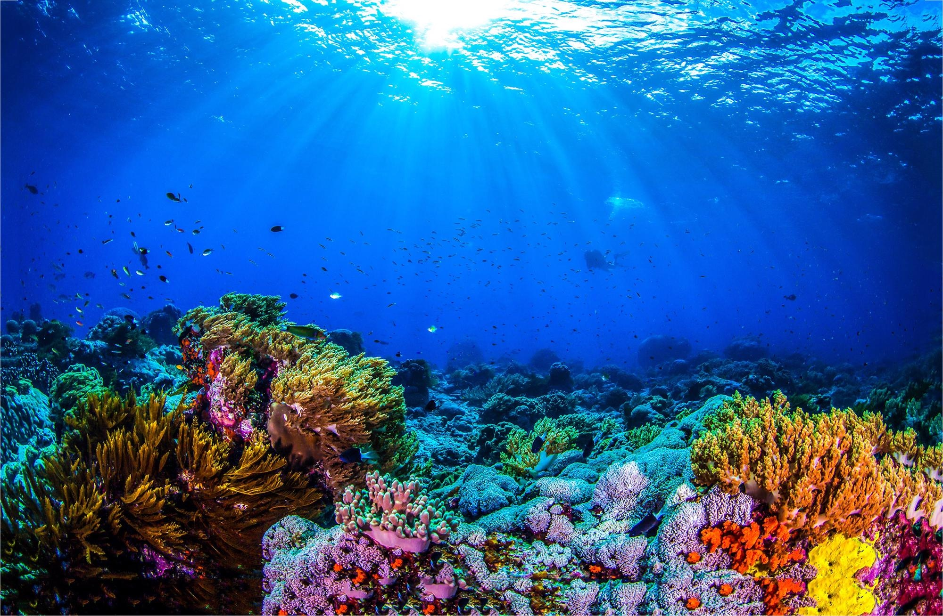
What might you see under water?
Find some pictures
Talk together
Move as if you are underwater
Make some underwater sounds

Slide 3
Listen and explore …
Blow some bubbles and follow them with your finger as they float through the air
Find something shiny and make it dance like a fish in the water
Fill a bowl with soapy warm water and enjoy moving your hands around in it

Slide 4
Listen to this song… what does it sound like?
Can you hear the voice singing underwater, underwater
Try joining in
Listen again and draw/write what else you hear in the song
Bubbles
Seaweed
Whales
Did you get them all?
Notes:
The underwater vocal line doesn’t stop throughout the song – it is an ostinato (if you want a posh musical word!)
For an enhanced sensory approach to the song explore bubbles during the first verse, wet lettuce / wilted cabbage in the second verse / and a whale bath toy / stretchy grey-silver lycra (to represent whale skin)

Slide 5
Listen and sing
Try singing the words
Bubbles underwater, ripple way down deep
Seaweed underwater, floating way down deep
Whales underwater,, swimming way down deep
Try singing underwater, underwater all the way through the song……
add some actions to the song

Slide 6
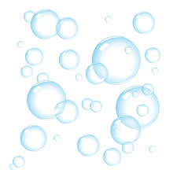
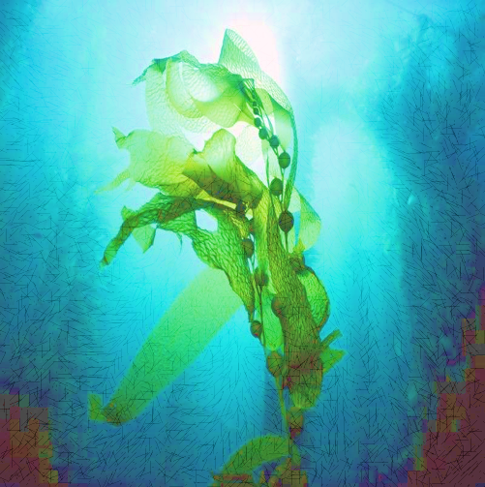
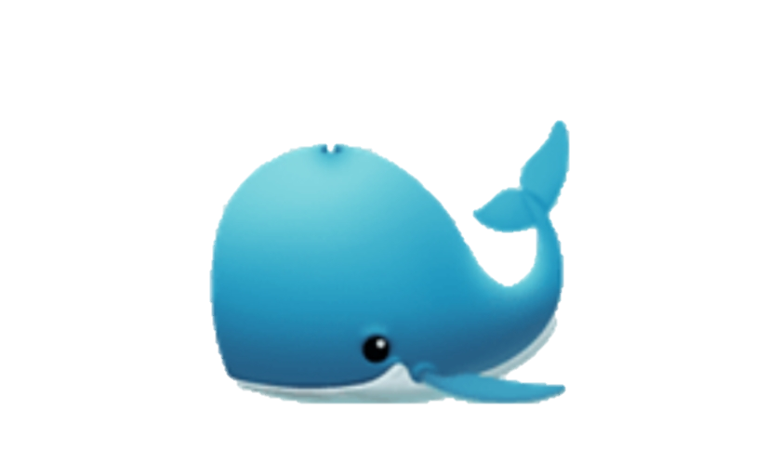
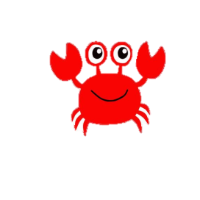
Sounds from our song
The song is about 3 things under the water
Bubbles
Seaweed
Whales
Can you think of a sound for each of these?
What other underwater sounds can you make?
PSSTT…..have a look on the next slide for some ideas
You could use other body sounds
You could use mouth or vocal sounds
You could use sounds you find around you

Slide 7
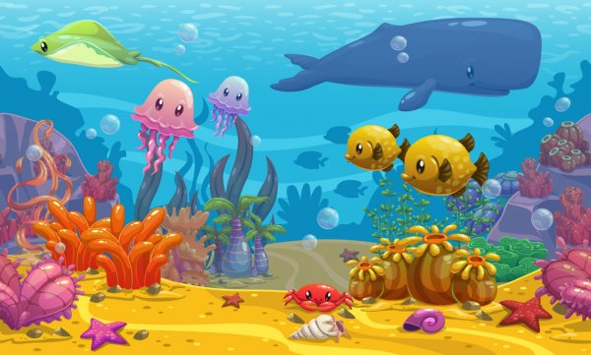
Your underwater sounds
Maybe your sounds could include some of these:
Make or find a sound to go with all the ideas you choose

Slide 8
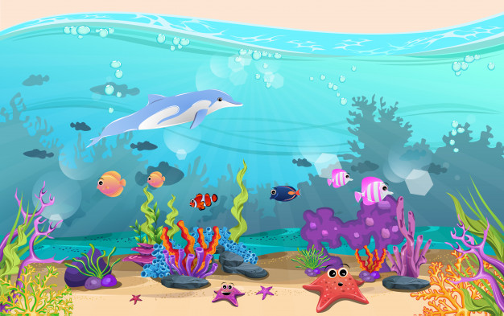
Your underwater music
Draw a picture to show which underwater sounds you have chosen
Don’t forget to include the bubbles, the seaweed and the whales.
Once you are happy with your picture and sounds, perform them along with the song backing track (above) creating your very own Underwater Music
Notes:
You could go on-line and choose underwater images rather than generating your own picture

Slide 9
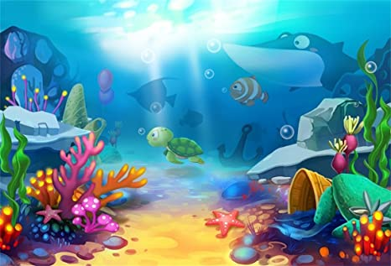
Woo hoo! Your music is splashingly
awesome!

Slide 10
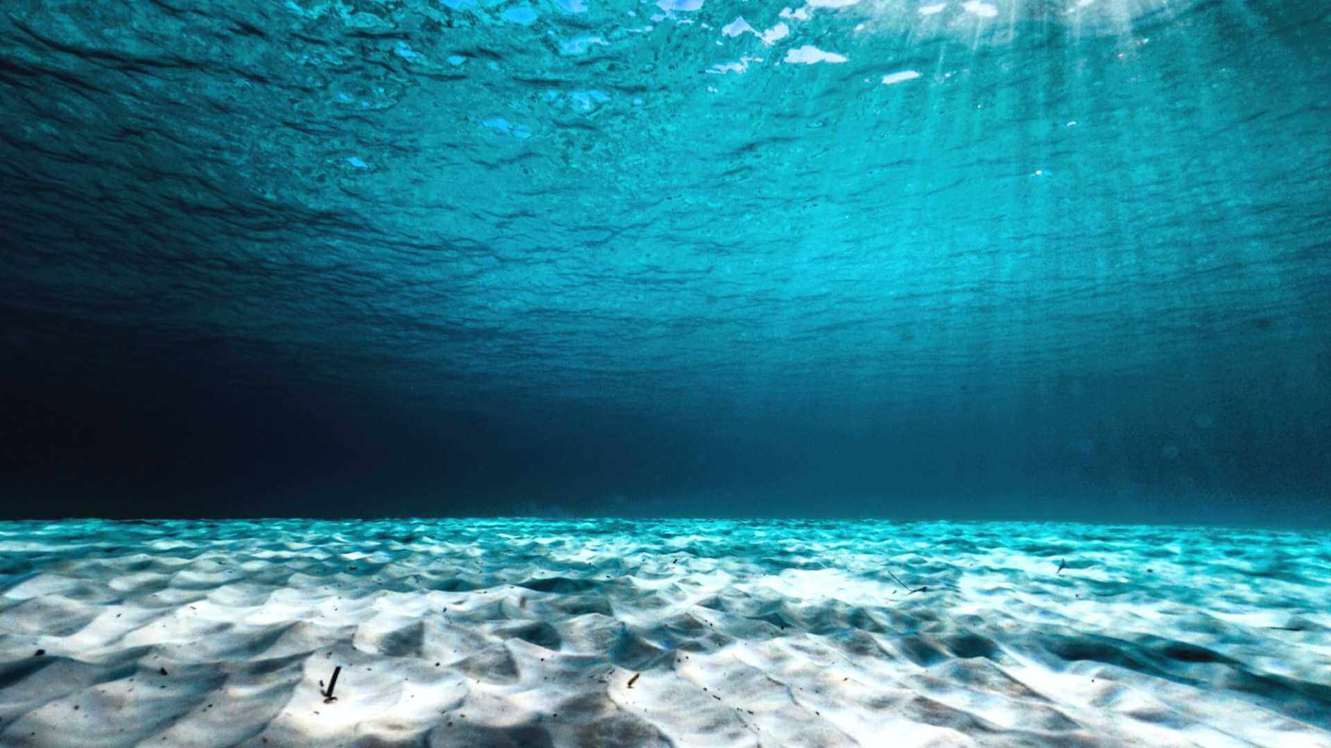
Additional sensory ideas… if you have time you could listen to the song and try out some more activities
Make a fish and move it along with music
Set up an underwater explore tray with aquarium stone, water, floating greenery, toy fish and other underwater creatures
Make an underwater collage using different materials eg foam, foil, glitter, netting
Explore different shells – how do they feel, what sounds do they make
Enjoy blowing and watching bubbles
Fill a glass bowl with water and look at things through it / in it, try adding drops of food colouring and see how it swirls in the water
Let your imagination swim free!

