Slide 1



Keep Calm and
Make Music
EASTER EGGSTRAS!
Musical fun and games

Slide 2
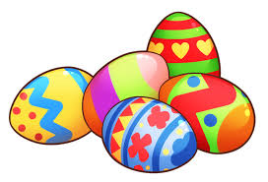

EASTER EGGSTRAS
Musical fun and games

Slide 3

Go on a sound hunt
Print this page and have fun ticking off the things you find
A banging sound A crunchy sound
A shaky sound A happy sound
A water sound A quiet sound
A bubbly sound A scary sound
An electronic sound A ticking sound
Which sound is your favourite ………………………..

Slide 4
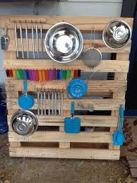
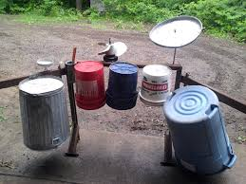
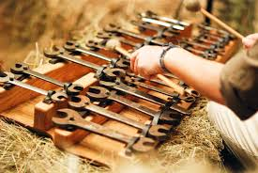
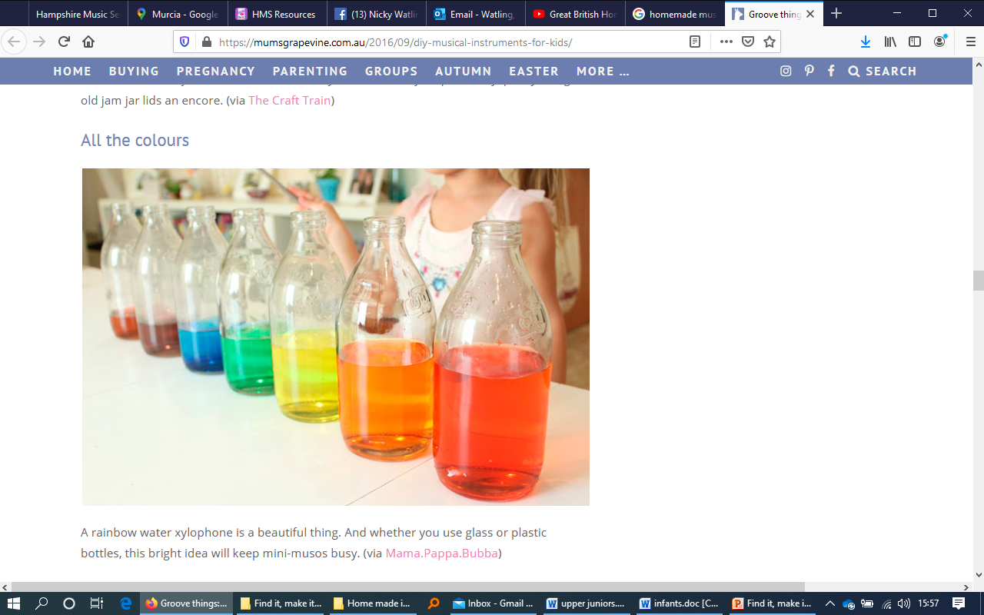
Find garden / kitchen sounds to play
How many different sounds
can you make?

Slide 5




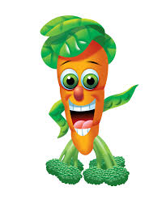
Make a sensory garden or
Go on a sensory walk
Be sure to include something
for each of our 5 senses
Hear Smell See
Touch Taste

Slide 6


Online singing and dancing
Click the links below to sing, dance and energise…
I’m so happy Shake our sillies out
The bunny hokey pokey Zumba Kids
Jailhouse Rock Cartoons Which Doctor
Don’t worry, be happy

Slide 7
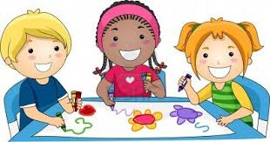
Musical colouring
Print the following slides or follow this link to download a free colouring sheet from the BBC
http://teach.files.bbci.co.uk/bringthenoise/colourings/be_in_the_band_colouring.pdf

Slide 8

Musical colouring
Print me out and colour me in

Slide 9

Musical colouring
Print me out and colour me in

Slide 10
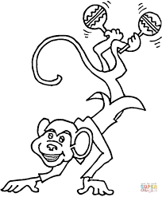
Musical colouring
Print me out and colour me in

Slide 11
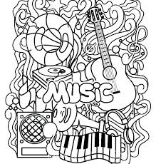
Musical colouring
Print me out and colour me in

Slide 12

Musical colouring
Print me out and colour me in

Slide 13

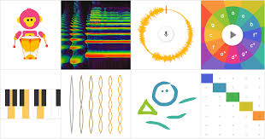

Fun Musical Apps
Here are some fun apps you could try:
Toca Band – App for iPhone/ iPad
Chrome Music Lab
find at: https://musiclab.chromeexperiments.com/
Incredibox
find at: https://www.incredibox.com/

Slide 14

Have fun working together

