Slide 1



Keep Calm and
Make Music
A Pizza Hut

Slide 2
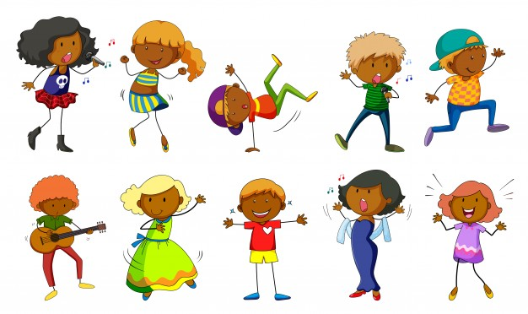
Getting creative with a song

Slide 3




Pizza Hut duration & texture
Sing the song together until you are confident with how it goes
Add some actions for each of the lines
  A Pizza Hut (draw a house in the air)
  Kentucky Fried Chicken (flap arms like chicken wings)
  McDonalds (draw the golden arches in the air)
Clap, say and count the syllables for each place
  A Pi-zza hut
  Ken-tu-cky fried chic-ken
  Mc-Don-alds
When you feel very confident (and if there are enough of you) try singing it as a round
Notes:
For singing in a round, start the second group after the first part have sung A pizza hut, a pizza hut, Kentucky fried chicken and a pizza hut twice
When counting the syllable, ask the children to clap each line and count the claps
A pizza hut 4 syllables
Kentucky Fried Chicken 6 syllables
McDonalds 3 syllables

Slide 4

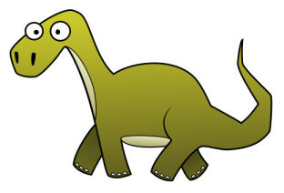
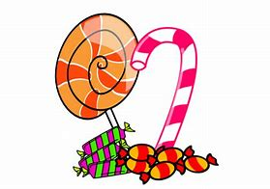
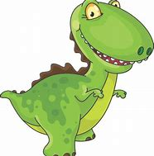
Make it your own…
  Think of a new topic e.g. Dinosaurs or Sweeties
  Make up a new set of words for each line
      Tri-cer-a-tops A strawberry lace
      Big, long dip-lo-do-cus fizzy cola bottle
      A T-Rex marsh mallow
Sing your new version and add actions
Try working in groups to come up with different songs that you can share with each other
Remember to clap the syllables to make sure they fit
Add your own actions
Notes:
Topics could include anything that the children could be interested in….
e.g. Sports (play basket ball / aim high at the basket / slam dunk it)

Slide 5
Take it a little further…with sounds
Explore some sound effects for each of 3 different ideas using body / voice / instrumental sounds
e.g. Triceratops: make a vocal “horn” sound
Diplodocus: make a long, slow sound
T-Rex: make a scary / loud sound
Try making a hand action that shows the sound
Try drawing a symbol that represents each sound, e.g.
triceratops diplodocus T-Rex
Explore different arrangements / sequences of these symbols to create some dinosaur music
Notes:
Try this idea out with your own idea too, making up your own symbols to represent the sounds you explore and decide on

Slide 6
Dinosaur music
Try playing this sequence:
And try playing this one
Now make up your own
Notes:
Use this slide to support the children when putting together a sequence – make each symbol a separate flashcards so that they can physically move the symbols around to make different sequences

Slide 7
Dinosaur Music
Try playing this pattern:
And try playing this one:
Now make up your own
Notes:
Use this slide to support the children when putting together a pattern – make each symbol a separate flashcards so that they can physically move the symbols around to make different patterns

Slide 8
Take it a little further…with rhythms
Use the rhythm patterns of each word
straw-berry lace fi-zzy co-la bot-tle marsh ma-llow
See if you can notate the patterns using a grid
Explore different sequences and patterns by using the word rhythms in different orders or repeating the rhythms
straw | berry | lace
X | XX | X
Fiz-zy | Co-la | Bot- | tle
XX | XX | X | X
M a r s h | Mal- | low
 | X | X
Notes:
Arrange the word rhythms / grids next to each other to create longer / more interesting rhythm patterns

Slide 9

Take it a little further…with layers
Create your own “Pizza music” by layering up your sounds or rhythms
Choose a sound to be your “dough” – this should be a steady beat played by one group e.g. swee-ties swee-ties
Choose one of your rhythms / sounds to become the first “topping” (layer) and play it on the top of your “dough” e.g. marsh mal-low
Next layer on another rhythm / sound to create a third “topping” e.g. mi-ni choc-late eggs
As a group decide how many “toppings” (layers) you want on your pizza music
Rehearse and perform it together
If you can, record it on an iPad and watch it back
Notes:
Ask the children to decide how they will start and stop their Pizza music – do they want to start with the dough and then gradually add the toppings on , or will they have a start signal and all start playing together.
Make sure they have decided how many times they will repeat their sounds / rhythms

Slide 10

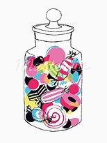
You could notate it like this…
1 | 2 | 3 | 4
Swee- | ties | swee- | ties
Marsh | Mal-low | Marsh | Mal-low
Mi-ni | Choc-late | eggs
1 | 2 | 3 | 4
x | x | x | x
x | xx | x | xx
xx | xx | x

