Slide 1




Keep Calm and
Make Music
Colours of the Rainbow

Slide 2

Do you know the colours of the rainbow?
(click to find out if you are right)
Red
Yellow
Orange
Green
Indigo
Blue
Violet

Slide 3
Can you sing a rainbow?
Click to Sing a Rainbow
Learn the makaton signs for the colours in
Sing a Rainbow with Mr Tumble
and Sing a Rainbow with Fairy Sarah
You can practise the song lots of times click here
Sing a Rainbow with words on repeat

Slide 4
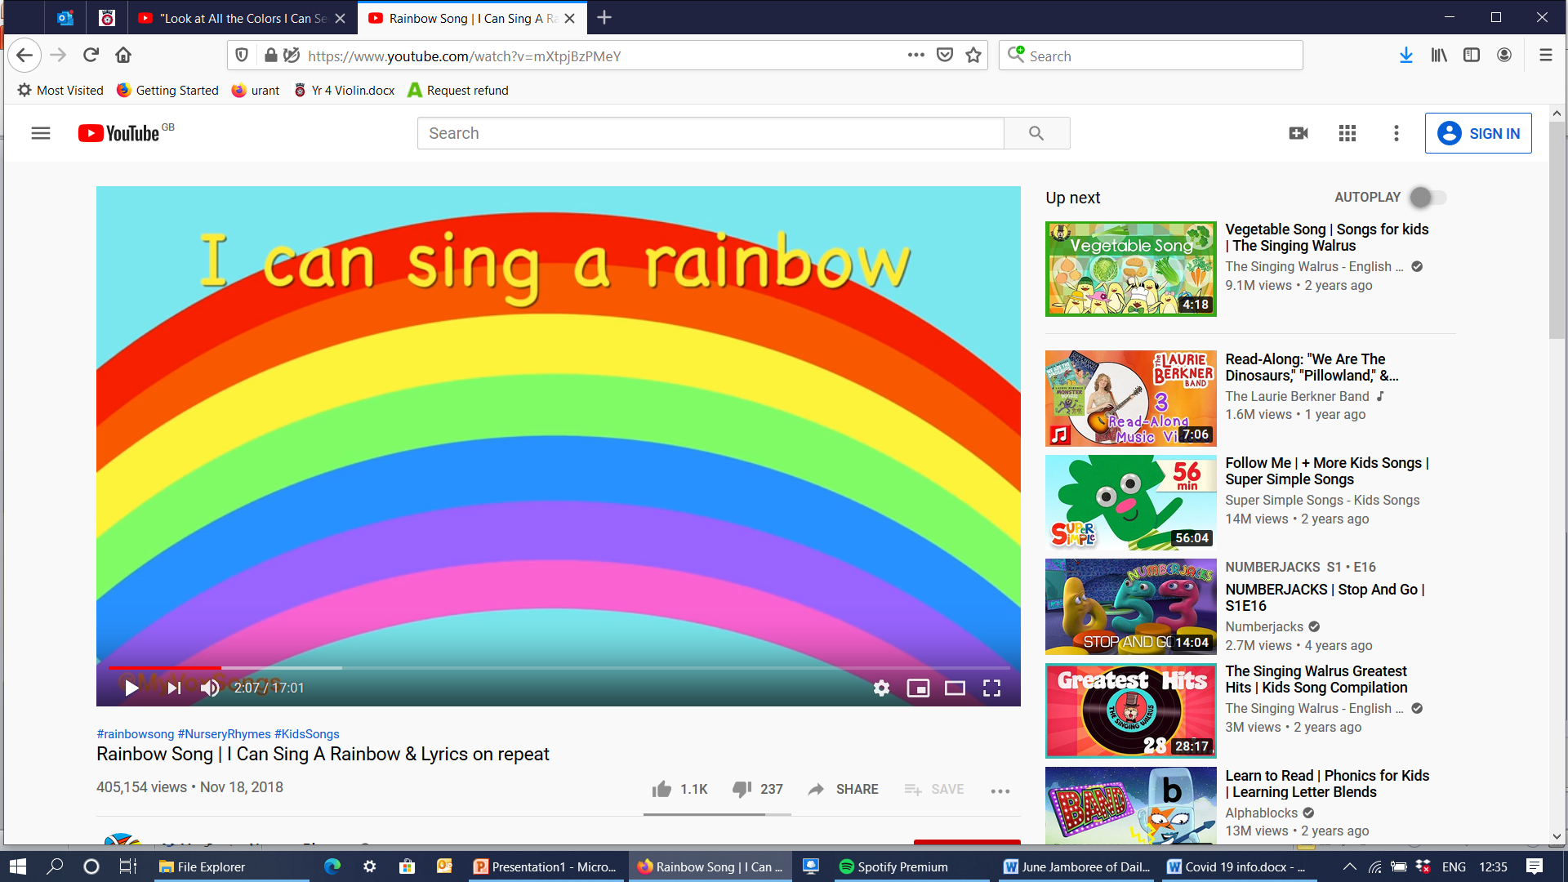
Can you sing the colours verse off by heart?
Can you add the makaton signs as you sing?
(Go back and watch Mr Tumble or Fairy Sarah again)
Why don’t you film yourself on the iPad and send it to some family members or just perform live for your family

Slide 5





Rainbow colours are everywhere
How many red things can you think of?
Click three times to get started
Draw or make a list of red things, look round the room you are in or out of the window. You could use a red pen or crayon to make your list

Slide 6
Rainbow colours everywhere
Can you find something to match every colour of the rainbow?
Listen to this Rainbows Colours Song for some ideas
Collect your colours of the rainbow and show them to someone

Slide 7
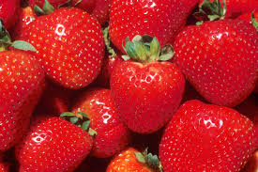
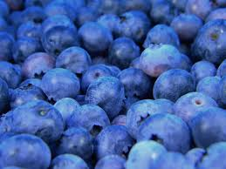
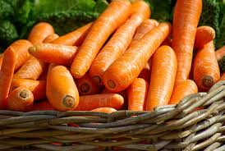
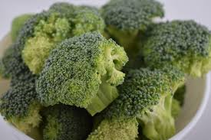
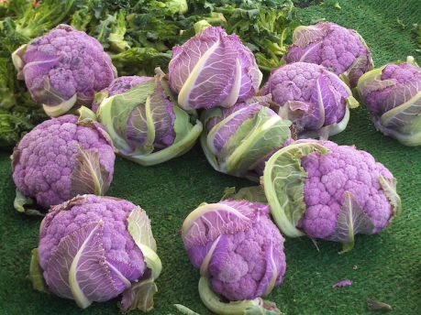
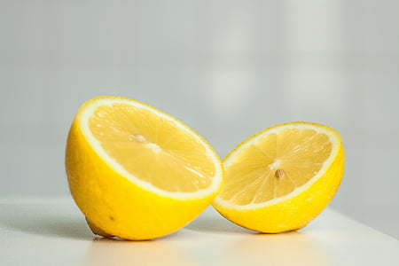
A rainbow of fruit and vegetables
Can you think of a fruit or vegetable for each colour of the rainbow?
Here are some to get you started (click 6 times)

Slide 8


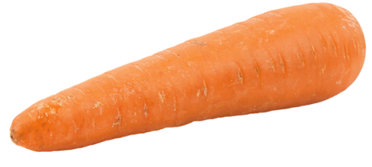

Make a rainbow of fruit and vegetables
Can you make a rainbow of fruit and vegetables?
You could draw some pictures
or cut some pictures out of a magazine
or even use real fruit and vegetables
(if you do this one take a photograph of it)
BUT always ask a grown up to help you

Slide 9




Let’s make some rainbow music -
To make a rainbow there needs to be rain and sun together so……………………………
To make your rainbow music you will need a rain sound, a sun sound and a rainbow sound
Click on the sounds below (there are two for each symbol)
Create your rainbow music:
Play the sounds one after another
Play them at the same time
Enjoy creating rainbow music by clicking on different rain / sun / rainbow sounds
rain 1 rain 2 sun 1 sun 2 rainbow 1 rainbow 2

Slide 10
Now for a bit of science and some facts about rainbows
Click on this link to hear
Dr Binocs explain how a rainbow is formed
See what else you can find out about rainbows
Like……did you know rainbows are a full circle?

Slide 11
Here are some more songs about colours for you to enjoy listening to
Here is another song about the colours of the rainbows for you to listen to and join in
Rainbows Colours Song 2
Look at your lists, drawing and photos as you listen
What is your favourite thing of each colour of the rainbow?
Click here for a song called Rainbow Connection from Kermit the Frog
Listen to this song all about lots of different colours
Look at All the Colours I can See

Slide 12

Congratulations you can sing, play and make rainbows!

