Slide 1



Keep Calm and
Make Music
Give me Courage

Slide 2
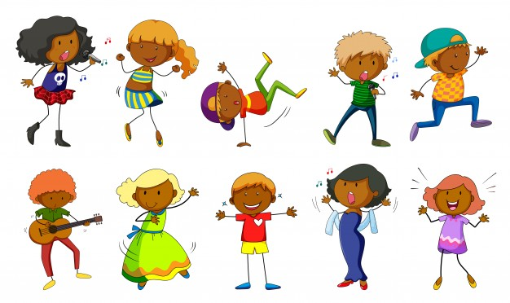
Getting creative with a song

Slide 3


Give me Courage….the song
Listen to the song
While you listen, make marks on paper to show the sounds in this song (are they smooth or spiky? what colours are they?)
Listen again and move your feet in time with the steady beat, then try tapping your knees in time to the steady beat.
How else could you keep the steady beat?
Listen again and see how much of the song you can sing along with
You can listen more
than once

Slide 4
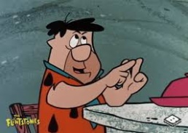

Listen again….
Count how many times you hear…
      courage
      brave
      dive in
Sing and move around the room in time to the steady beat. Can you make your movements really strong and powerful?
Can you find something to play to keep a steady beat while you are walking?
If you have some paint available, try making some strong, bright shapes, marks and patterns while you listen to the song.
Find some pictures of people doing brave things and make a collage.

Slide 5

Give me Courage….the movie!
Click play on the blue square to watch some real courage

Slide 6



Being brave…
…keep a brave face…
This song has a call and echo section – hoi! hoi!
When you sing along, practise being the echo (copying the Hoi!)
Next time, have a go at being the Caller (calling Hoi! first)
Hoo – Haa, a Call and Echo Game
    With a partner – One of you calls “Hoo” and the other one echoes. Try calling twice – hoo hoo for your partner to echo. How many can you do?
    Swap over so you each have a chance to be the leader
    Add arm actions to your call and your partner has to copy you
    Try the same with Haa!
    Try mixing your Hoos and your Haas
    Make up your own brave sounding word and “be brave” calling and echoing from different places around the room
Hoo
Haa

Slide 7
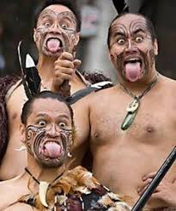

Get prepared…
Make strong, scary faces in the mirror
Practise making different brave stances while you play and sing the song (arms / legs)

Slide 8
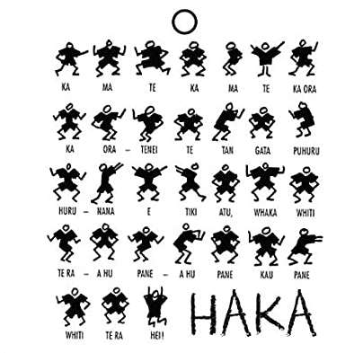
Watch this clip of a HAKA.
This uses strong, rhythmic actions
alongside chanting
Work out a sequence of
strong / brave poses
Hold the pose for each phrase
Create a sequence or
pattern of poses to
accompany the song
Practise and get it ready to perform

Slide 9

…and show yourself off…
Share your performance with someone – maybe you could record it on an iPad and share it with someone else in your family or class.
If you’re at home, maybe you could perform whilst face-timing a friend or relative
Enjoy !!

Slide 10

Exploring more about courage
Click on the picture below to hear the book Courage by Bernard Waber being read aloud.
You could share this together and talk about the times when you have shown courage

