Slide 1

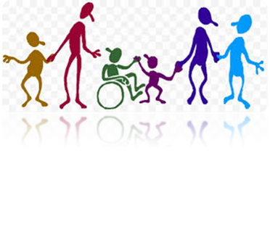

Keep Calm and
Make Music
Here comes Sally

Slide 2
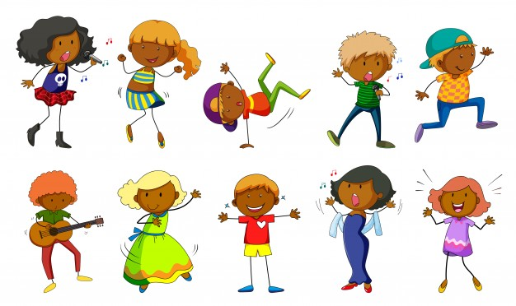
Getting creative with a song

Slide 3
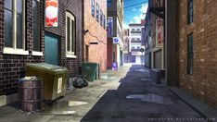

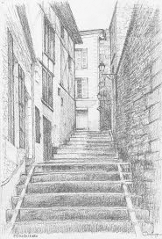
Here comes
Sally
This is a traditional playground song from North Carolina, USA
Listen to the song and join in as soon as you can
Sing the song and stomp on the spot
Clap the “Just like that” phrase as you sing it
Make a circle and walk around one way, then the other way while singing the song
Clap the steady beat while you are singing
Keep on singing the song through until you know it really well
Notes:
To see a clip of some children playing this game have a look at this clip:
https://www.youtube.com/watch?v=eUJSs_9VXNM

Slide 4
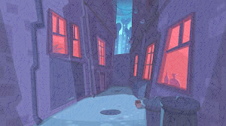
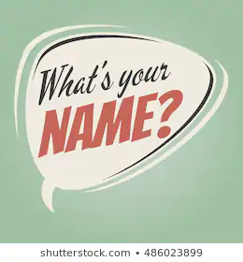
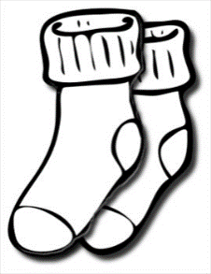

It’s all about you this time
Sing the song again but this time, change the name Sally for your name e.g.
Here comes Ethan, walking down the alley…
Make sure everyone in the group has a turn
When your name is called walk into the middle of the circle and do your thing!
If there are quite a few of you, try calling in groups instead of names e.g.
Here come the white socks, walking down the alley
Or
Here come the blue eyes, walking down the alley

Slide 5
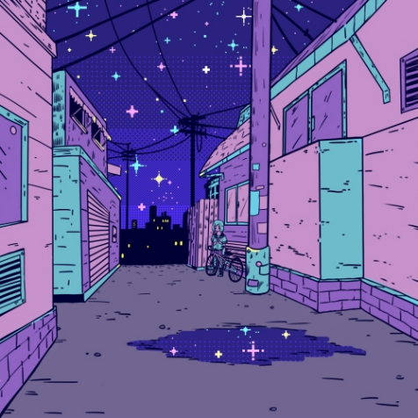


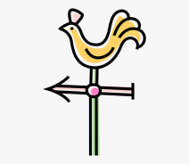
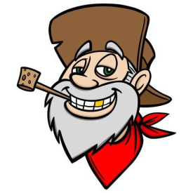
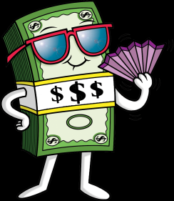
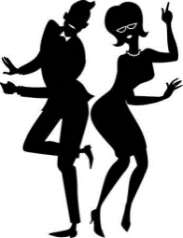

Try the long version
This is a longer version – sing the first 2 verses and listen to the rest
Click on the words when you hear:
West five dollars
what did I see?
man from Tennesse
East
shimmy my best
Did you hear them all? Now try singing the whole song

Slide 6
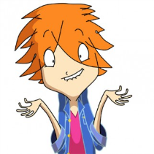


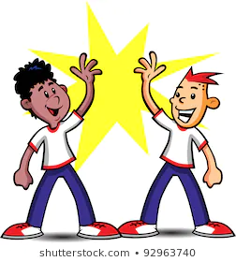
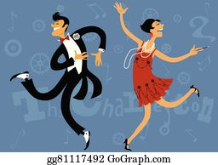
Adding in the extras…
Can you think of some actions for:
What did I see?
Big, fat man from Tenesse
Five Dollars
Jump to the East
Jump to the West
Shimmy my best
Add them into your song as you sing it
Try adding clapping or playing the rhythm for just like that each time you sing it
Which other words would you like to play the rhythms for? You choose which ones would sound good.
I bet you can think of some great ideas

Slide 7

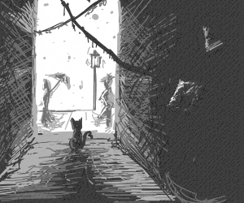
Just like that…
Just like that (sh) just like that,
Everybody’s playing just like that
Try chanting this together, clapping the underlined words to keep the steady beat
At the end of the chant, see who would like to clap / play their own pattern for everyone to enjoy
You could see if the solo pattern player can play a pattern that everyone could echo back

Slide 8
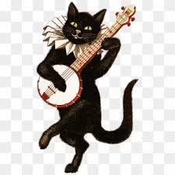
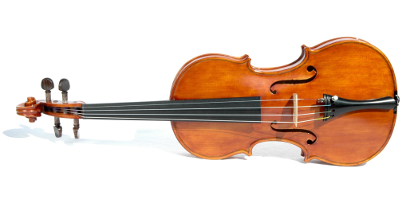
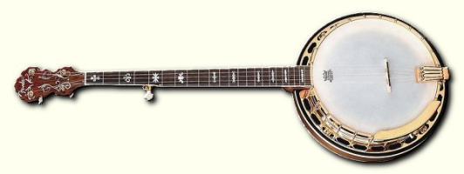
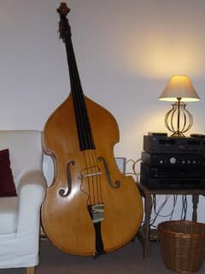
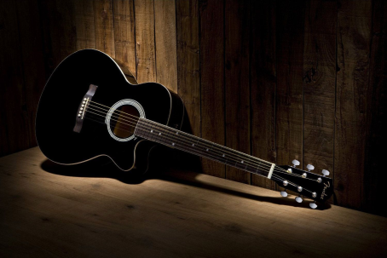
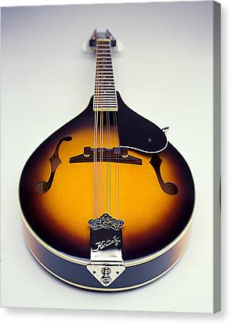
North Carolina’s music
North Carolina is known for it’s Bluegrass music
The main instruments used in Bluegrass are:
Banjo Fiddle
Guitar
Mandolin Bass
Click to hear Wheel Hoss played by the CFR Bluegrass Band and hear all the instruments
What does it make you want to do?
Notes:
Start the clip at 0.52 if you choose to skip the introduction to the instruments

Slide 9
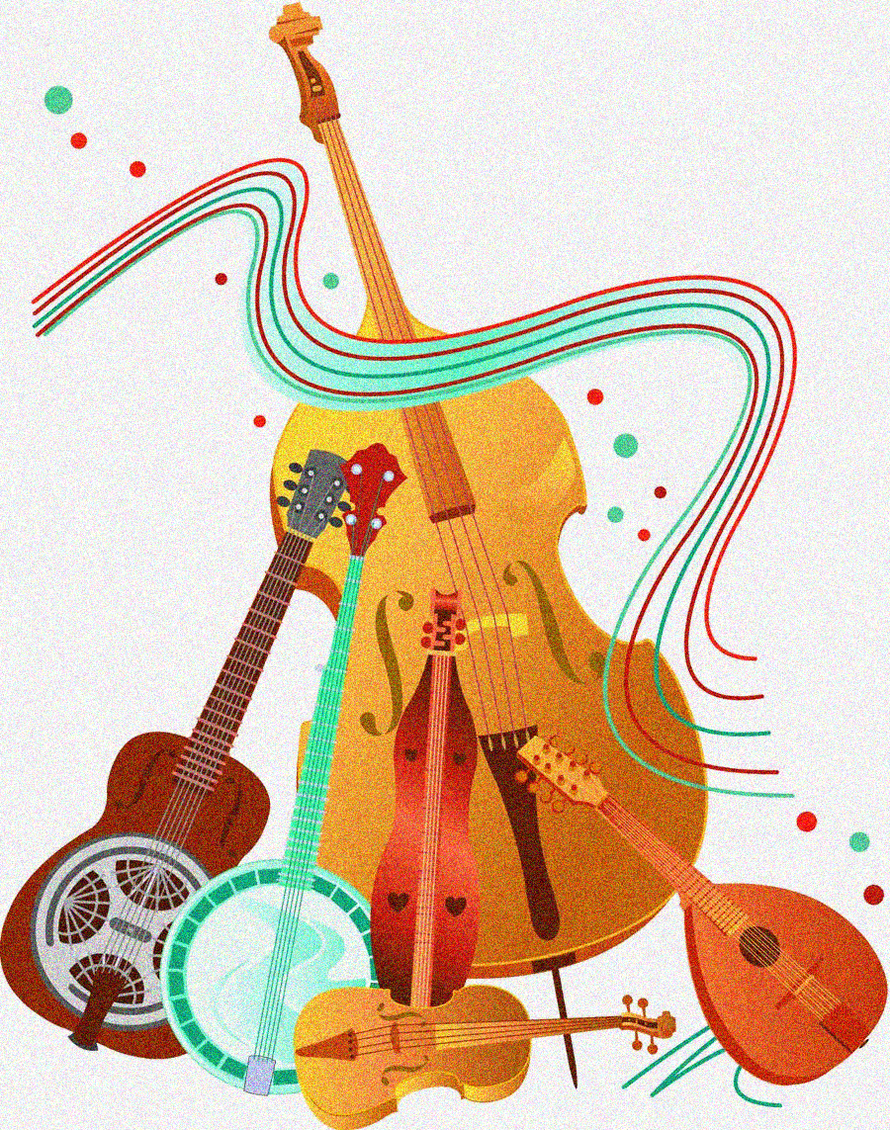
Do your thing
Just like that!

Slide 10

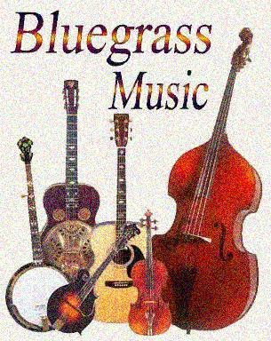
If you have more time to listen, check these out…
Spoon Lady - Angels in Heaven
Duelling Banjos
Foggy Bottom Boys - Lord, I'm coming home
Have fun!

