Slide 1



Keep Calm and
Make Music
Marvellous Me!

Slide 2
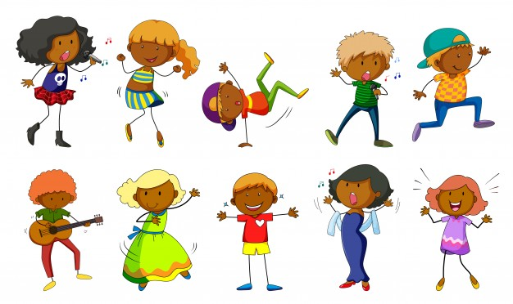
Getting creative with a song

Slide 3
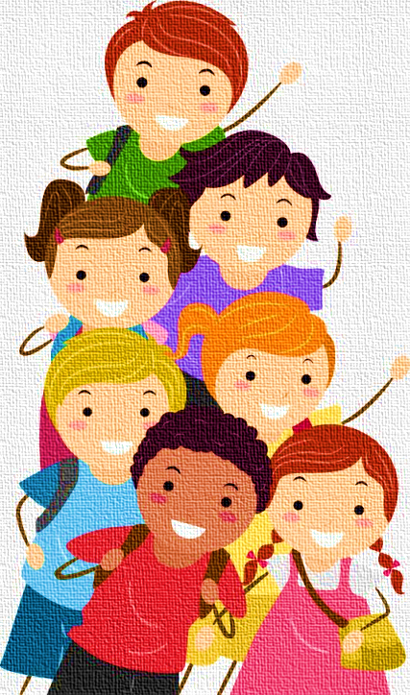




Marvellous Me
Listen to the song
Feel the long notes – stretch your arms wide apart to show
the long notes
Meeeeeeeeeee yoooooooou
Find a scarf, ribbon or something similar and listen to the song again, stretching the fabric between you hands as you hear the long notes
Explore your own long sounds
ooooo
aaaaa
eeeee

Slide 4

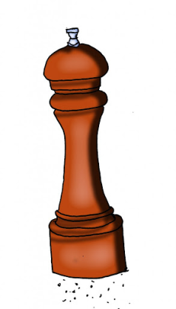
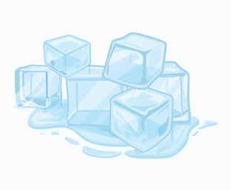

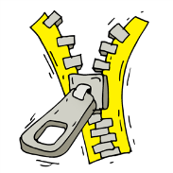
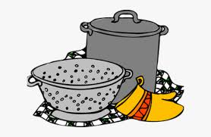



Long and short sounds
Explore sounds in your environment (in school or at home)
Can you find sounds which are long?
Which sounds are short?
Can you make long and short sounds with the same things?
Try sorting them into groups of long sounds and short sounds
Try playing your long/short sounds with the song backing

Slide 5

Long and short sound patterns
Here is a symbol which shows a long sound …try playing it
And this one shows a short sound … try playing this too
Use your favourite sounds to play this pattern…
Now try this pattern

Slide 6


More long and short patterns
Could you make up your own pattern?
(there are some short and long symbols on the next page that you could print and cut out)
Could you make your own symbols to show short and long?
Try creating your own patterns using your long and short sounds – find someone who can have a go playing yours and see if you can play theirs.

Slide 7
Long and short symbols to cut out

Slide 8



Time to….
Here is a piece of music called
  Eternity by Vangelis
Enjoying wiggling and jumping to the short sounds at the beginning and then stretch with the longer sounds
Try using a
scarf or ribbon
as you move

Slide 9
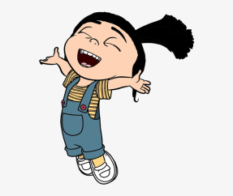



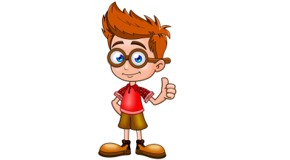

Listen to the song again….
Join in with the singing, really singing the long sounds
Make up your own actions to the words
Make a list of all the things that makes you a superstar and show it to someone special
Draw a picture of yourself and put all of your marvellous things around the picture.
Tell someone else why you think they are fantastic
Perform the song with your actions to someone at school, at home or while you are face-timing them

Slide 10


You are a

