Slide 1



Keep Calm and
Make Music
Superhero

Slide 2


Slide 3
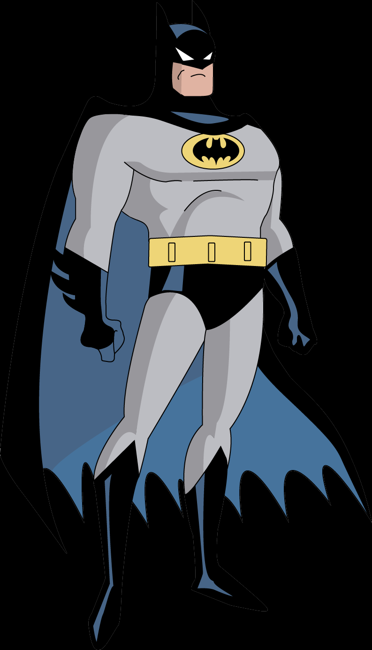


Na-na-na-na-na-na-na-na…
Listen to this song about Batman
Each time you hear the na-na-na-na-na-na-na-na section, see if you can join in
How many times do you hear the na-na-nas?
Listen again to double check!
Work out an action for the na-na-nas
Listen again singing the na-na-nas and adding your actions too
Shout every time you hear it!

Slide 4




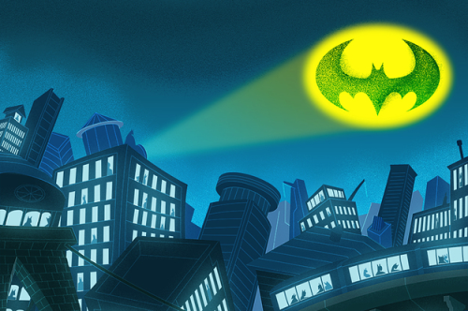
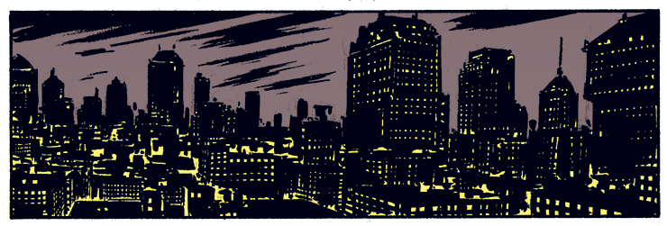
Batman bingo
Listen really carefully to the song paying special attention to these words and when you hear them for the first time, give each word a click…
help
Batmobile
mask
cape
neighbourhood Batlight

Slide 5

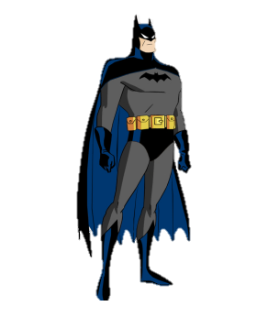
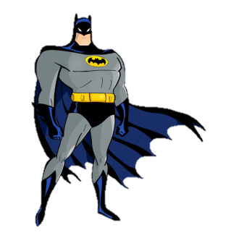

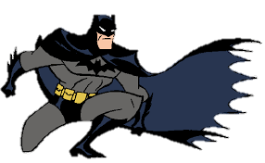
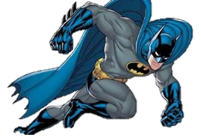
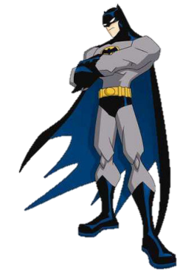


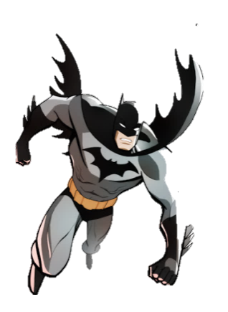
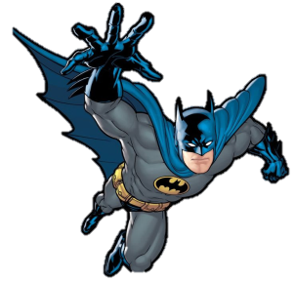
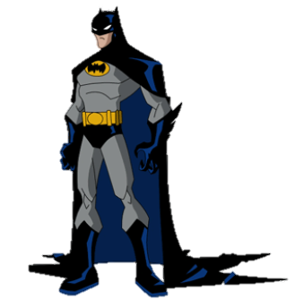
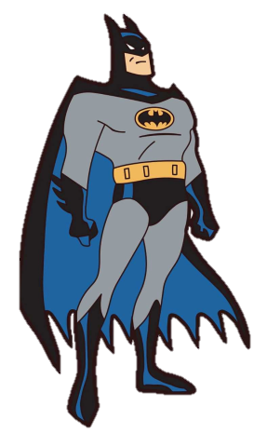
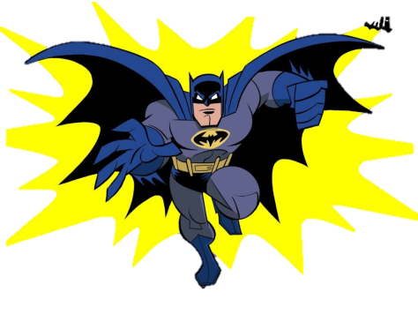


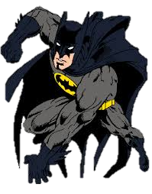
Listen and sing along
While you join in with the song this time, click every time you hear and sing “Batman”
How many did you hear?

Slide 6
17
Did you get them all?

Slide 7

Rhymers
Before you sing again see if you can remember what rhymes with these words in the song:
Batmobile and
Mask and
Batlight and
Neighbourhood and
Trouble and
Who and
Now try singing the song adding in all the words you know
wheel
task
night
good
double
do

Slide 8

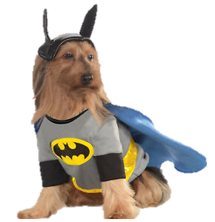

Put it all together
I bet you have the words sorted now, so sing the song all the way through
Make up some actions for each verse
Add your na-na-na actions
Add a steady beat on your knees, with your feet or using a sound maker
Could you dress up?
What else could you do to make an exciting performance?
Perform the song and record your performance on a tablet, phone or iPad to share with someone else

Slide 9




Batman..
The superhero
What does Batman do? Talk to someone about it
Watch this clip of the original Batman theme- tune
Listen to what happens in the music when you see the
and and in the clip
Batman theme
Did you work out what Batman does?
He helps people

Slide 10
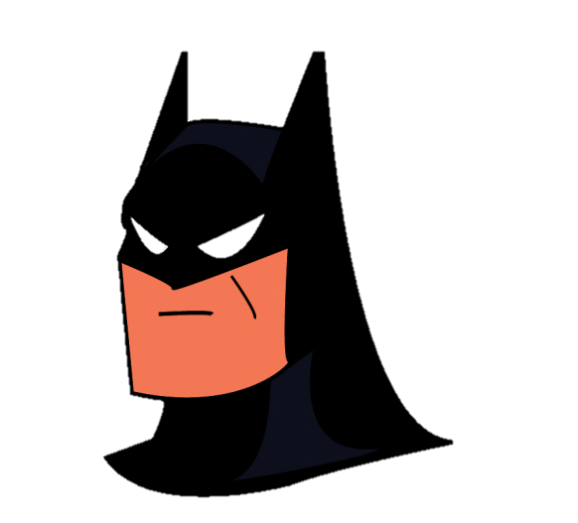
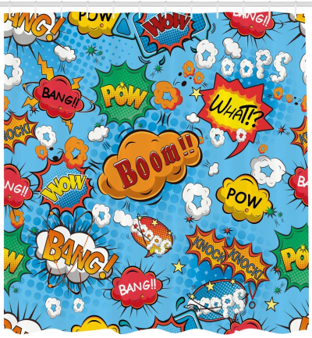




KABOOM!
How many different words can you come up with?
Find some different sound makers that will give you those sounds, or try out using sounds you can make yourself for your pow / bam words
Add your sounds to the Batman backing track (above) and see if you can tell a batman story by using your sounds over the top of the backing track

Slide 11

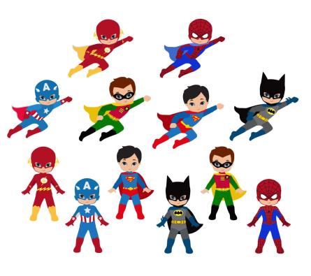

Super You
Have a chat with someone and think about what makes a superhero
Make a list or draw your ideas
Find some paper and draw yourself in the middle
Think about all the great things you already do
Put them all around your picture and make it into a poster
Fabulous……….

Slide 12

You
Already
Are
A

