Slide 1

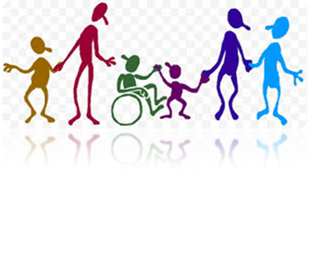

Keep Calm and
Make Music
You Got Rhythm

Slide 2


Can you feel the beat?
Listen to Only time will tell by Mike Oldfield
Can you hear the beep? (Yes I can?)
The beep is the steady beat of the music – it’s like your heart beat
Listen again and tap or clap along to the steady beat
Can you move like a robot to this music?

Slide 3
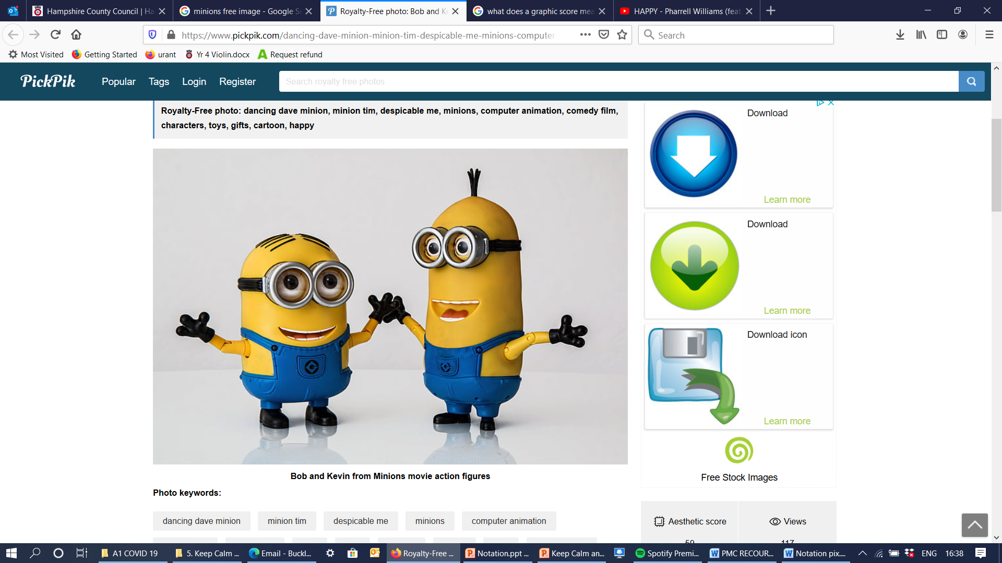
The steady beat is the heart beat of the music
Listen to a favourite song or follow
the link to Happy (with the Minions)
Can you tap the
steady beat along
to the music?

Slide 4
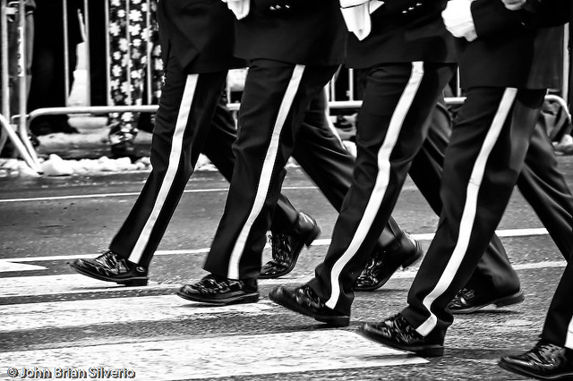

March along to the beat
Listen to some marching band music
Massed Pipes and Drums
Watch the soldiers feet
The soldiers in the band march in time with the steady beat of the music. Left, right - it is counted in groups of 2 because we march with two feet
Listen again. Can you march to the steady beat along with the band? Say left, right, left, right and march around the space you are in

Slide 5
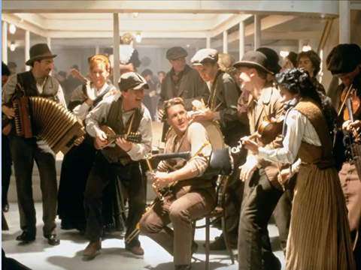
Dance along to the beat
Listen to some Irish dance music from the Titanic soundtrack Irish Party in Third Class
The people in the picture are dancing and clapping along to the steady beat. Use different body actions along to the beat – you could tap, clap, nod or click
If you are feeling energetic you could jump or hop or even dance around but try and keep in time with the beat
Watch out after about two minutes the music changes and the beat is faster

Slide 6



Have you got rhythm?
Watch this clip from Phineas and Ferb
Ain't Got Rhythm – the man working in the library doesn’t think he has got rhythm?
What do you think? (I think he has!)
Have you got an old book that you could use to
keep the beat along to the music while you watch? You could tap it, open and close it or pretend to stamp it along to the beat (please ask a grown up which book you can use!)

Slide 7


What is rhythm?
Watch Sweet Beets 1 to find out about rhythm
Join in and copy the rhythms you hear
Can you clap or tap this rhythm from the video (click 5 times)
that’s beet beet cher - ry beet
Don’t forget beet is one sound because it is one syllable
cher-ry is two sounds because it’s two syllables
Notes:
You could also use familiar objects with 1 / 2 syllables to personalise the learning for each child e.g. ball / teddy or drink / pizza using the actual items rather than pictures if it makes more sense

Slide 8

Print this page and make up your own rhythms – here’s one to get you started
1 | 2 | 3 | 4
Don’t forget you can only have one picture in each box
Clap each rhythm for someone to copy
Notes:
You could cut out the pictures / use your familiar objects and respond to those, moving them into different positions and creating your rhythms that way

Slide 9
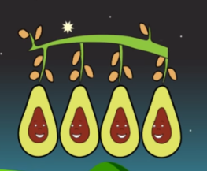
More rhythm and a sh
Watch Sweet Beets 2 to find out more about rhythm and a sh
Join in and copy the rhythms you hear
Can you clap this rhythm from the video (click 5 times)
that’s av-o-ca-do av-o-ca-do beet beet
Don’t forget av-o-ca-do is four sounds because it has four syllables (beet is one sound and cher-ry is two sounds)

Slide 10

Print this page and make up your own rhythms – here’s one to get you started
1 | 2 | 3 | 4
 |  |  | sh
Don’t forget you can only have one picture or a “sh” in each box. Clap each rhythm for someone to copy

Slide 11

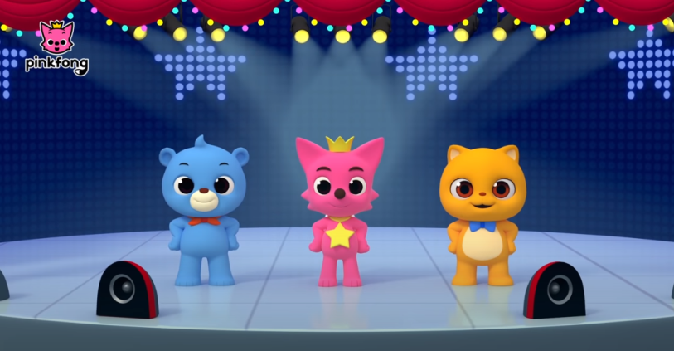
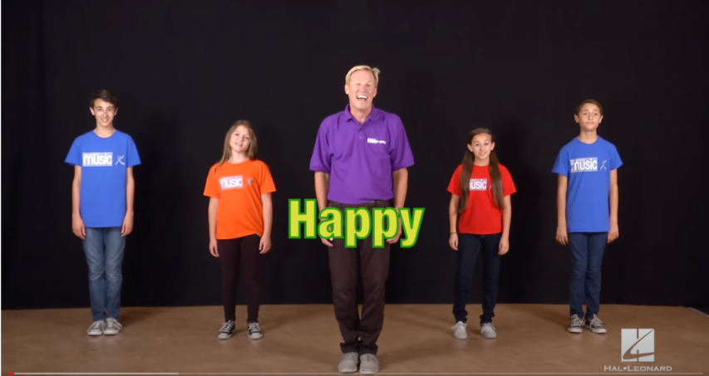
You have got rhythm!
Try joining in one of these dance songs
Watch, tap along to the beat, join in singing and then join in the dance
I've got the rhythm
Happy

Slide 12

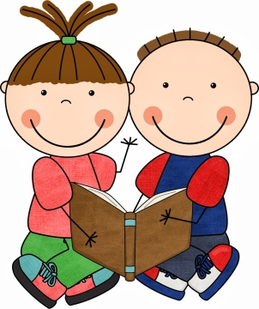
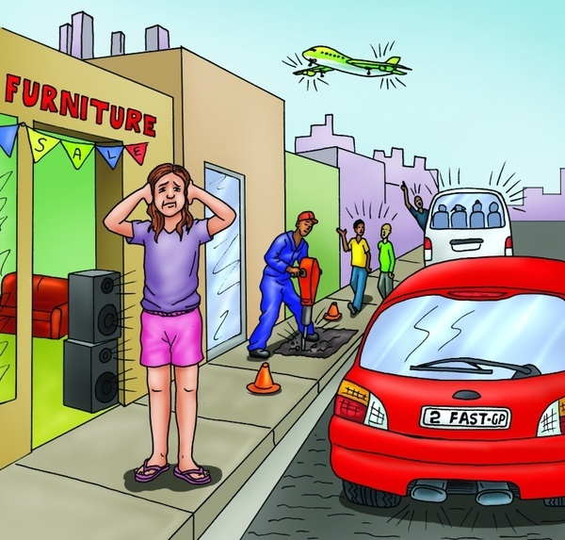
Feeling tired?
I got the rhythm – audio book by Connie Schofield Morrison
Make sure you are sitting somewhere comfortable and enjoy this short story
Can you hear different sounds
and beats around you when
you go outside?

Slide 13
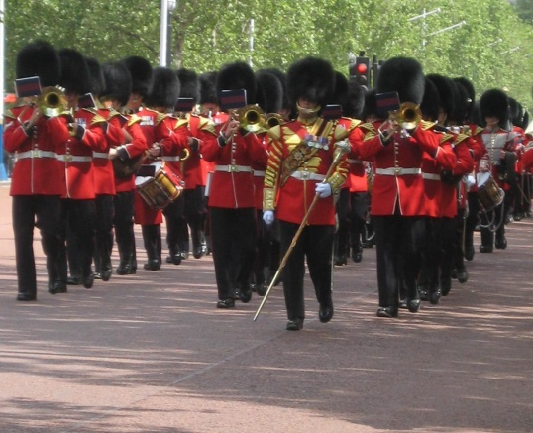
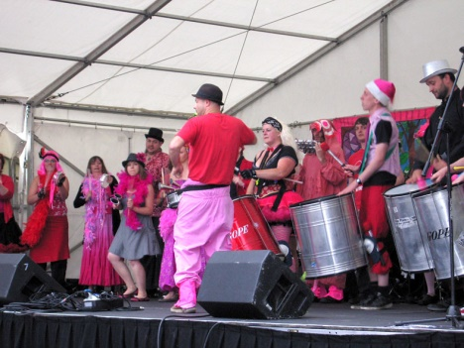
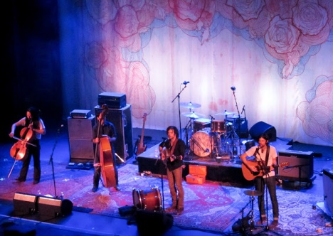
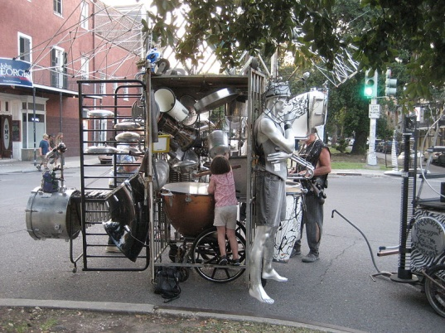
Here is some more music to listen to and keep the steady beat tap, clap and move
Famous British Marches
Samba Band
Jessica's Welcome
Weapons of Sound Neilson

Slide 14

Well done you are a star
I have got rhythm!

