Slide 1


Slide 2

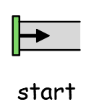



(or begin)
(or finish)
12

